Slide 1
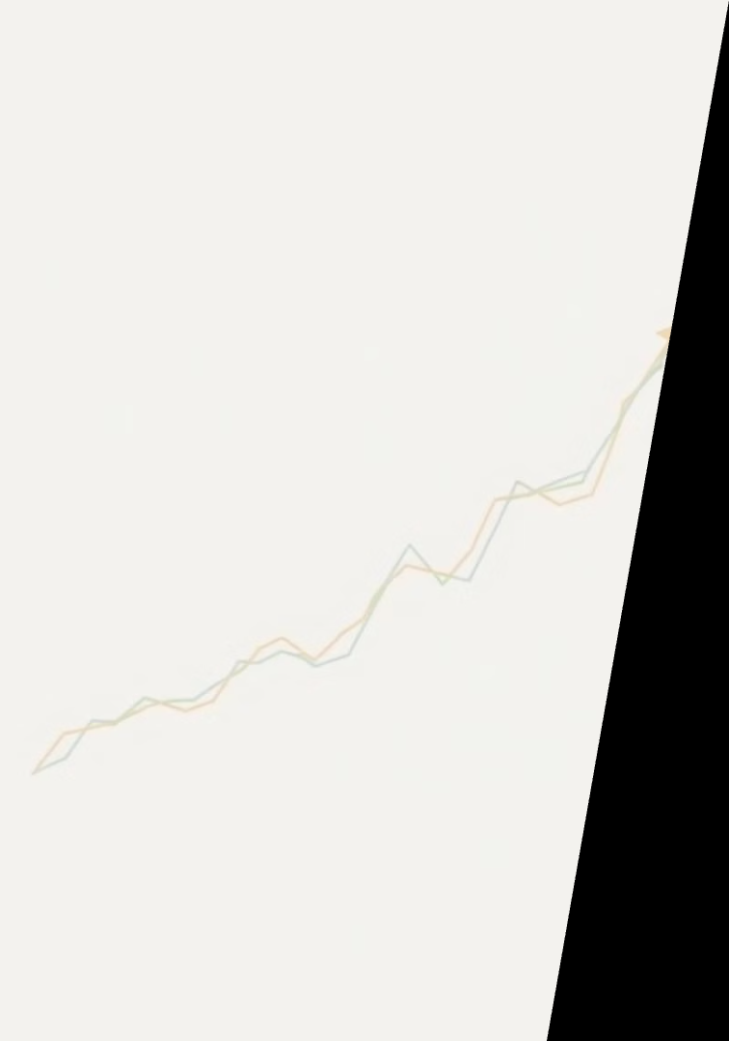

Title: Stock Price Prediction Subtitle: Predicting Tomorrow’s Stock Prices with Machine Learning
Kushagra - (202401100400121)
Mahima - (202401100400116)
Mandira - (202401100400119)
Naveen - (202401100400121)
Nidhi - (202401100400124)

Slide 2
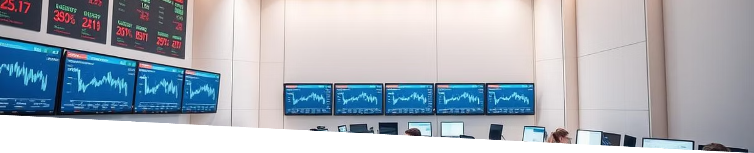




What is This Project About?
In this project, I tried to predict tomorrow’s stock prices
Using past data.
I used machine learning (regression) to do this
This can help investors or traders make better decisions.
📈 It’s also a great way to learn how machine learning works
In real world finance.

Slide 3

Show trends using graphs and charts.
What I Wanted to Do
Check how accurate the
model is
Show trends using graphs
and charts.
Use past prices to predict
What the price will be the
Next day.

Slide 4
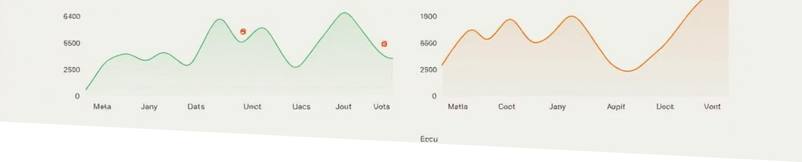
I used NIFTY50 stock data from Kaggle.
About the Data
I used NIFTY50 stock data from
Kaggle
It contains daily prices from 50
companies (2008–2020).
Includes details like Open, High,
Low, Close, Volume.

Slide 5





Getting the Data Ready
Removed missing
values and cleaned
the data.
Created a new column
for next day’s
closing price
Split data into training
and testing sets.
Scaled values to improve model results.

Slide 6




Training and Validation
I first used Linear Regression (simple model).
Then I tried better models like:
1] Random forest
2] XG Boost
Compared them to see which one works best.

Slide 7
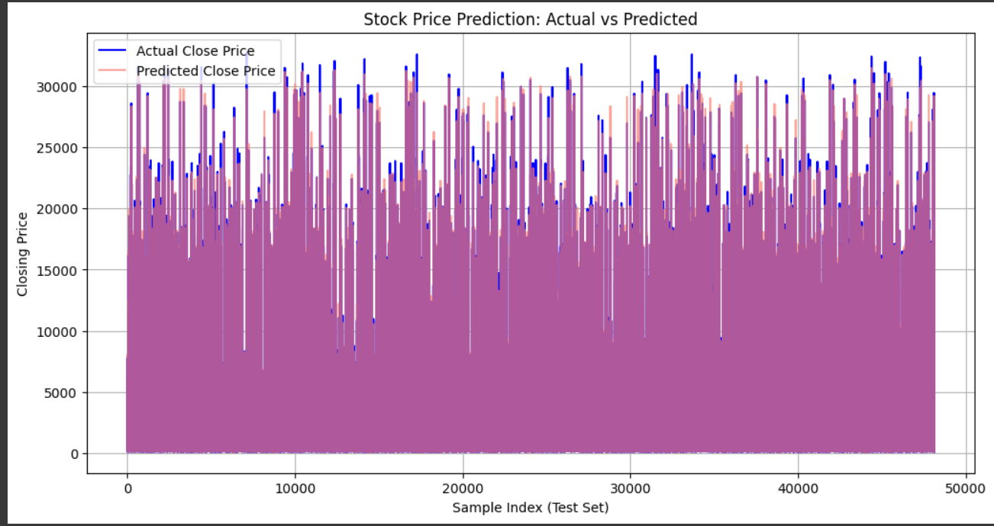
Results: Model Performance
XGBoost achieved the best RMSE of 4.70. Lagged prices and volume were the most important features driving predictions.

Slide 8
Visualization of Predictions
The plot illustrates predicted versus actual prices. This helps assess model fit visually.
Residual analysis confirmed no heteroscedasticity. It indicated good normality.

Slide 9
Limitations and Challenges
Stock market volatility and unpredictability are inherent challenges.
Risk of overfitting to historical data remains a concern.
Feature selection bias can skew model outcomes.
Real-world transaction costs are not modeled.
Market impact is also outside current scope.

Slide 10
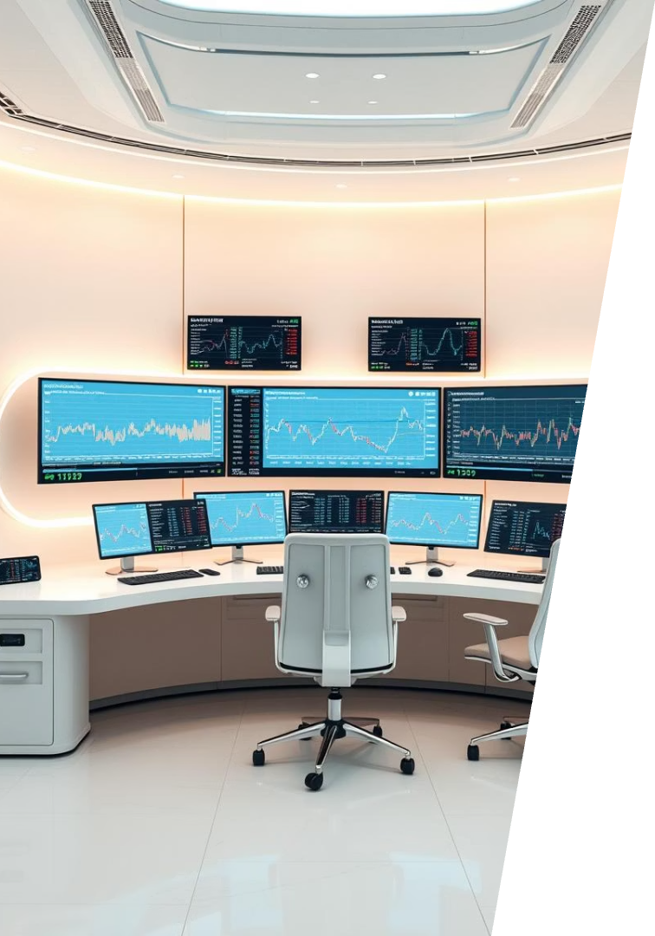




Future Directions
Sentiment Analysis
Incorporate news article sentiment for better insights.
Deep Learning
Utilize LSTMs for enhanced time series forecasting.
Expand Scope
Apply models to multiple stocks and sectors.
Live Deployment
Implement model in a paper trading environment.

